Slide 1
Self Neglect – Isle of Man adopts its multi agency policy
Cath Erine

Slide 2
Take a bow!
The Isle of Man has developed a multi agency policy and supported this with multi agency training, despite having no legal requirement to do so
A number of multi agency events have been held over the last 15 months to engage all partners in the development of the policy
Training was provided earlier this year to “test drive the policy and organisational commitment to its implementation.
The conference today is the formal launch of the policy.
Why is it important?
Notes:
Mention care act and MCA

Slide 3
Why is it important?
Impact on Adults
Impact of workers
Denial Guilt
Helplessness Self doubt
Stress Anger
Illness Isolation
Distress
Fear Shock
Loss of Self esteem
Leaving the profession or team
Feeling special, the “one”
Feeling judged
Loss of family, friends, home, status
Embarrassment Worthlessness
Sense of failure Helplessness
Negative impact on physical and/or mental health
“In control” but with negative costs
Financial costs Anger
Isolation Denial
Notes:
Add some information from Ann in Sheffield and the other research cases from Bedford university.Stress the need for multi agency working

Slide 4
Key messages from the research completed by Sussex university for SCIE and the DoH
Understanding the causation? Links with
Physical Health issues | Mental Health Issues | Substance Misuse | Psycho-social factors
Impaired physical functioning | Depression | Alcohol | Limited or non existent social networks (impact of limited resources)
Pain | Impaired cognitive functioning | Other drugs – prescribed or not | Poor experience of/or access to health and /or social care
Nutritional deficiency | Anxiety or psychosis |  | Traumatic histories/life changing events

Slide 5
Understanding the lived experience of self neglect
Negative Self Image – demotivation | Different Standards – indifference to social appearance | Inability to Care
I got it into my head that I’m unimportant, so it doesn’t matter what I look or smell like
I’m drinking, but not washing or eating. I’m not losing the will to live – that’s too strong but I just don’t care what people think
It makes me tired, daily routines are exhausting even doing the simple things like getting washed or finding clean clothes
I wouldn’t say I let my standards slip – I didn’t have any. Never had
I’ve always neglected my own feelings, I didn’t address them. I thought that “my feelings don’t come into it”

Slide 6
The lived experience of self neglect – on the adult’s home environment
Influence of the past – childhood, loss | Positive value of hoarding – sense of connection | Beyond control – obsessions
The only way I kept toys after xmas was by hiding them
I want things that belonged to people so that they have a connection to me
The distress of not collecting is much greater than the distress of doing it!
When I was a little boy, the war had just started, everything had a value to me – it still has value or potential use now
I don’t have time to make a note of everything in the paper I’m interested in so I’m very fearful of throwing anything away in case I lose something important

Slide 7
Organisational context
Eligibility Criteria
Care Management models
Discharged – non engagement
Performance management
Thresholds that limit or prevent preventative work
Time limited interventions
Charging policies
Increased demand and limited resources

Slide 8
Self neglect – the challenges
“The combination of people who are terrified of losing their independence or of state intervention; combined with a state process that is desperate to apply eligibility criteria and find reasons NOT to support people, is just lethal. “Oh – you’re saying it is all fine – thank goodness, we can go away and respect your views”
ADULT’S RELUCTANCE TO ENGAGE
ORGANISATIONAL PRESSURES

Slide 9
Robust interagency working
Shared strategic Ownership
Clarity on roles and responsibilities
Strategy into operational reality
Interagency policy and governance
Referral pathways
Commissioning
Forum for shared risk management
Time and space for relationship based work
Training, supervision and support
Case coordination and leadership

Slide 10
What does the Isle of Man policy say….
Is based on the six core principles of the Care Act and the Mental Capacity Act and applies to adults aged 18 plus who have mental capacity to make the decisions causing the concern
Single agency interventions have failed to reduce the risks to the adult
The risk(s) to the adult are likely to result in serious harm or risk to the life of the adult
Must make active attempts to engage the adult to identify measures that will reduce the risk, this may mean discussing with the adult the involvement of an advocate and/or family/friends
Choosing the “best person” to have the initial conversation with the adult, who has maintained a trust based relationship with the adult

Slide 11
What does a trusting relationship look like?
Interventions delivered as part of an emotional connection/trust – an ability to challenge the adults without judgement working with them at their own pace (on issues they view as “important” to them – which may not be the priority of the workers/organisations” “He has been human, that the only word I can use – human and on my level”
Support that fits with the individual’s own perception of need with practical interventions when necessary “When X came along they were hands on – we’ve got to do this…..shall we start cleaning up now” “She got it into my head that I am important that I am on the earth for a reason”
Respectful and honest engagement “ He’s down to earth, he doesn’t beat around the bush. If there’s something wrong he will tell you. If something needs sorting he will tell you and support you to do it”
“Care-frontational” challenges – not discounting unrealistic options but working with any options that are likely to been acceptable to the adult that are have a high chance of success

Slide 12
Mapping the risks
Putting the adult central to the assessment and if agreed involving family/friends – even if professionals believe that they may be “part of the problem”
Once the risks are identified and some agreement reached about their priority, the adult should be asked to explore the impacts (Current and possible if nothing changes), what are the impact of the adult and workers/agencies not taking opportunities to take risks/make changes?
The adult should be supported to say if they are “Keen to try this”, “may be willing to do this” or “ not willing to do this”
From the keen to and may be willing to try agree the roles and timescales of all involved in managing the risks
This mapping needs to be revisited on a regular basis to evidence change and empower the adult to take additional actions.

Slide 13
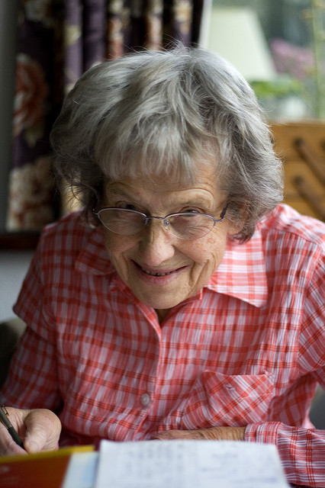
Finding the Key….
“Betty” – Former teacher, no family. In social housing refusing to allow people into the house so utilities cut off. Lots of books/newspapers. Fire risk to neighbours. Eating poorly due to lack of cooker, only shops once a week buying close to end date food. Landlord considering eviction
Mobile library highlight of her week, the only person she has meaningful conversation with
Self Neglect risk assessment completed – mobile librarian supported to discuss concerns with Betty who agreed she would like to be able to “stretch her brain”. As a result she joined a local book group after being supported to buy some new clothes (second hand shop). The new network boosted her self worth and led to engaging with housing - utilities restored after safety checks completed.
Case example

Slide 14
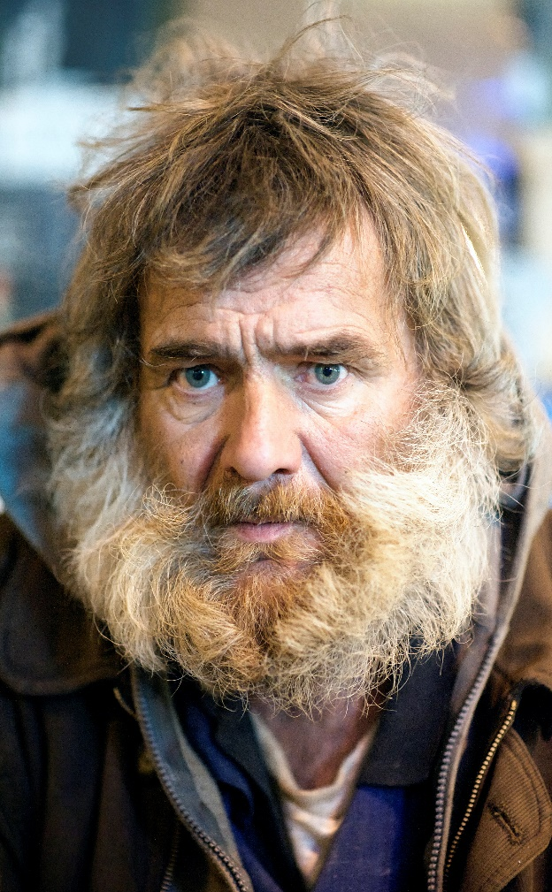
Case example – finding the key (what is causing the self neglect?)
Jack – 47, evicted from temporary accommodation for fighting with another resident, 7 months ago and is now living rough. Jack has a history of alcohol misuse, which commenced after breakup of his marriage – 10 years ago. Jack is a qualified joiner and had his own business, which collapsed 7 years ago.
He has two children, but they refuse to see him due to his alcohol misuse.
Jack has diabetes , which is poorly managed. He had a stroke affecting his right side – weakness which leaves him vulnerable on the street. He has been admitted to hospital several times in recent weeks with significant injuries. Jack has refused to name the perpetrators. The admissions to A&E have been linked to complications of his diabetes. There are concerns he may lose limbs if he fails to manage his diabetes more effectively.
Key intervention – Offer from son to re-engage with his dad and to support contact with grandchild if he addressed his alcohol issues. Jack was detoxed and has remained largely sober and lives in a supported tenancy and is looking to volunteer with ex-offenders developing practical skills

Slide 15
Scoring the risks
Does NOT replace professional opinions but support evaluation of the impact of the work completed with the adult/multi agency response
Two elements – Risk to the adult ( 1, 2 or 3) multiplied by Likelihood of the risk (3, 4 or 5). All cases that score 10 or over should be managed within the self neglect policy and commitment given by all agencies to deliver the agreed action plan
If the score is less than 10 BUT we need a multi agency response the policy should be used
ALL cases will be coordinated by the Safeguarding Adults office
The risk management plan and impact should be evaluated regularly at meetings or virtual meetings
The adult must be encouraged to engage with the process

Slide 16
Exiting the self neglect journey
The risks are reduced to a level that all parties feel are acceptable
All interventions have been attempted, by a range of workers/agencies and non professionals and no agreement has been reached with the adult to accept any of the interventions (this decision must be taken in a multi agency forum and documented in detail). The adult must be told how they can make contact, should they choose to
The adult dies or is detained under the Mental Health Act Or criminal justice processes.

Slide 17
Any questions?
Thanks for your attention

