Slide 1
‘Safeguarding is everyone’s business’
What has safeguarding to do with me?

Slide 2
Community Safeguarding
What does this mean?
Working together to keep our children and young people safe and protected from harm
Introduction from David Gawne - Chair

Slide 3
In Our Community
Uniformed organisations, eg Scouts, Guides
Church groups and congregations
Youth Clubs
Dance, Performance groups
Art groups
Sports
Pubs, Shops, Post Office, Hotels

Slide 4
Sport in the Community
Sport and the Community have a close relationship
We are surrounded by sports clubs delivering a wide range of activities to children and young people, but
Sport for long periods of time buried its head in the sand
Sport didn’t haven’t any safeguarding issues!
Notes:
Sport and the community are synomonous with each other
Sport is the corner stone of the community
Children and young people are crucial to the future of sport in the community
Sport has an open dor to children and young people !

Slide 5
Sport in the Community
Former British Olympic Swimming Coach Paul Hickson was jailed for sex attacks on teenagers in his elite squads
Stories from gymnastics, athletics and tennis
More recently football has been under the spotlight
Notes:
Most sports have had serious safeguarding issues at some point which thank fully has led to a change of culture and values

Slide 6
Sport in the Community
Sports needs to constantly review how it keeps the door firmly shut to predators
As a minimum requirement sports must work to towards offering children and young people a safe and positive experience.
To do this:
Procedures and Policies that include safe recruitment introduced
DBS Checks – free for volunteers
Safeguarding awareness training – Free
Play Sport Stay Safe leaflet - Questions to ask when you drop of your child at a community sport session

Slide 7
Sport in the Community
Clear lines of communication + support
National Governing Body i.e. Football Association
Local Association eg IOM FA
Community Clubs
Notes:
If there is an issue there is a route to follow and support in place – again its key that clubs, local associations speak to each other, i.e. clubs have a welfare officer, that can speak to the local associations welfare officer, and there is support in place from the National Governing Body.

Slide 8
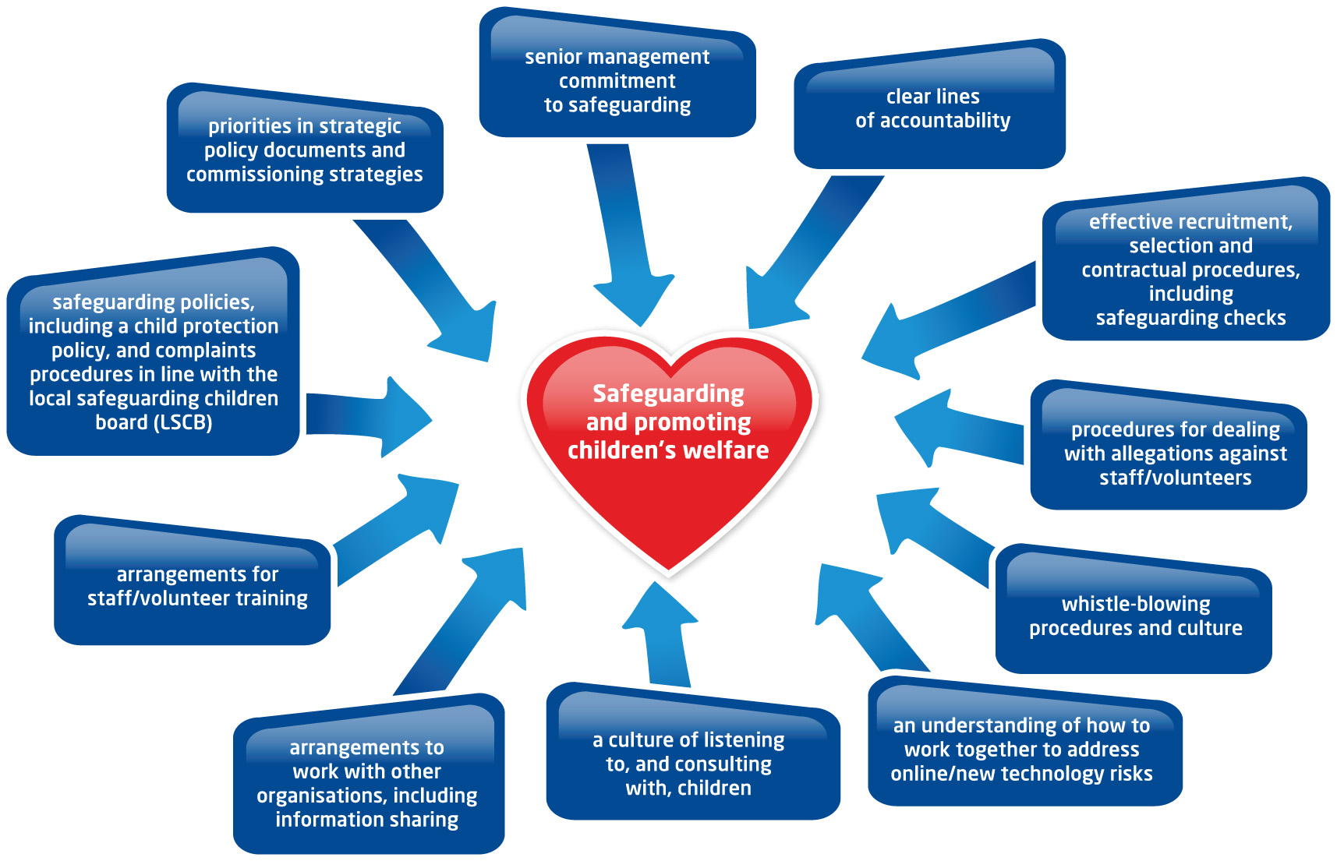
Sport and the Community
Notes:
This diagram illustrates clearly the direction of travel sport and safeguarding are taking, children and young people welfare and safety are key and everyone is working to that end, just reinforce a few examples

Slide 9
Scenarios to work through
Split into groups of about 5, from different backgrounds if possible

Slide 10
Feedback

Slide 11
Scenario 1
I often hear arguments from my neighbours house late at night and sometimes crying and screaming from the children.
What can I do?
Who do I contact?
What might happen next?

Slide 12
Scenario 2
I work in the evenings and head home around 10pm. Almost every night I see 2 primary age children from my street sitting on the bench at the end of the road. I worry as they are out in all weathers. I think their Dad is in the pub but I don’t want to interfere.
What can I do?
Who do I contact?
What might happen next?

Slide 13
Scenario 3
There is an elderly lady who lives on my road. She lives with her son. I noticed last week she had a black eye. Over the years I have seen her with injuries such as a broken wrist. She keeps herself to herself.
What can I do?
Who do I contact?
What might happen next?

Slide 14
Scenario 4
It is pretty obvious to me that there is something dodgy going on at a house across from me. There are all sorts coming and going at all times of the day and night. I think he is dealing drugs and there are children in the house.
What can I do?
Who do I contact?
What might happen next?

Slide 15
Scenario 5
I volunteer at a local charity. There is an elderly man who attends twice a week for lunch. Recently, I have noticed his appearance has deteriorated, he has lost significant amounts of weight and he smells.
What can I do?
Who do I contact?
What might happen next?

Slide 16
Processes for Safeguarding Children What happens next?
You have a concern about a child
Referral
Assessment
Child in need – services provided with agreement of family
No specific services required
Child at risk of significant harm
Notes:
Refer again to ‘What to do it you’re worried a child is being abused’ Dfes. This explains the process and copies are free
The Referral Process
Not all referrals turn out to be child protection concerns. This is the process you should follow if you have a concern about a child:-
discuss your concerns with your manager or designated person in your organisation for safeguarding children
if you still have concerns and feel the child and their parents would benefit from services, consider which agency you should make a referral to
if you are not sure which agency or feel the child might be at risk of significant harm contact (insert here the name of the Children’s Social Care team which takes child protection referrals)
They will either advise you about the appropriate agency or undertake an initial assessment within 7 working days. In cases where the child is not at risk of harm you will need the parent’s/carer’s permission to make a referral. This assessment will show what services if any are needed.
The assessment that the child is, or is not, at risk of continuing significant harm may be made at any stage of the process

Slide 17
What happens next?
Crimestoppers number 0800 555 111
Police HQ – 631212
Duty Social Worker 686179, OOH 631212
Out of hours Adults – Hospital Switchboard
The Safeguarding Officer/ Welfare Officer, in your organisation
Contact any Professional within Police, Health/ Mental Health, Education, Social Care
Website – www.isleofmanscb.im

