Slide 1
Principles of Signs of Safety in Practice Thoughts into actions
Safeguarding & Quality Assurance Unit Present:

Slide 2
Agenda
Thoughts behind Signs of Safety approach
The child’s voice
Case study
Signs of safety in action
What parents and professionals say
Questions

Slide 3
Why Signs of Safety?
Andrew Turnell and Steve Edwards
Eileen Munro
Working together to Safeguard Children
Child’s voice lost within focus on adults
Outcome focused
Notes:
Created in Western Australia during the 1990s by Andrew Turnell and Steve Edwards, the approach is based on the use of Strength Based interview techniques, and draws upon techniques from Solution Focused Brief therapy (SFBT).
It aims to work collaboratively and in partnership with families and children to conduct risk assessments and produce action plans for increasing safety and reducing risk and danger by focusing on strengths, resources and networks that the family have.
Parents say they are clearer about what is expected of them and they receive more relevant support.
• the approach encourages transparent decision-making
• the professionals have to be specific about their concerns for the child’s safety, this encouraged better presentation of evidence
• the degree of protective elements and of actual or apprehended risks could be set out visually for all to understand than lengthy reports
• once set out the risks did not have to continually be revisited
• the group could acknowledge strengths and meetings could focus on how to achieve safety
In the Munro Interim report, the use of Signs of Safety by a local authority in the North East of England was highlighted as one example of “the type of systemic learning and adaptation that the review wishes to encourage. The [authority has] identified problems in the existing way of working and, drawing on theory and research, have formulated ways of improving practice” (Munro 2011a: 64).
Turnell (2012) summaries three core principles of the approach:
i) Establishing constructive working relationships and partnerships between professionals and
family members, and between professionals themselves.
ii) Engaging in critical thinking and maintaining a position of inquiry.
iii) Staying grounded in the everyday work of child protection practitioners.

Slide 4
Embracing the Signs of Safety Model …A solution focused approach to build safety for children
Collaboration between Agencies
Partnership with Families
Professional Knowledge
Family Knowledge
Harm/Future harm and danger
Strengths & Safety
Notes:
Andrew Turnell and Steve Edwards talk about the importance of partnership work, not just with families but also between professionals. Eileen Murno talks about the importance of relationships between professionals and parents – a collaborative approach
Balance of professionals understanding of risks from previous, current and potential for future risks and families knowledge and understanding of the risks.
Balance of the harm with what is keeping a child safer with a grounding of child protection concerns.

Slide 5
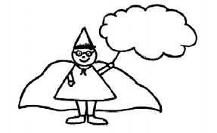
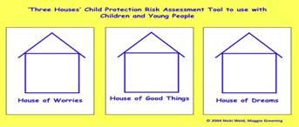
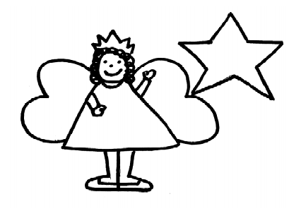
The child’s voice

Slide 6
Impact of hearing the child’s voice at Conference
The Signs of Safety Model embraces “the voice of the child” as a central focus during Child Protection work with the family.
Hearing the voice of the child/young person within conference has been shown to have a real impact on the outcome of Conference. A recent example of this is that conference members stated that they had changed their decision based on what they had heard from the child during the Conference.
Notes:
Voice of the child.

Slide 7
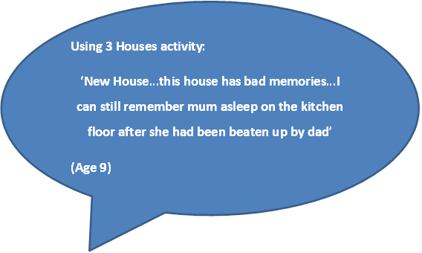
Direct Quotes from children and young people
MOMO Statement:
‘…I feel frustrated that mum says she is going to stop but she doesn't. It's hard to remember a time when she wasn't drinking’.
(Age 10)
Safety Wizard:
‘My mum’s boyfriend has gone away, he always shouts’.
(Age 8)

Slide 8
Thoughts into actions
Risks and vulnerability ----------------------- What we are worried about | Protective factors ----------------------- What is keeping child safe | Impact on the child ----------------------- What we are seeing in the child/ren
Alcohol – parent returns intoxicated and is abusive Domestic abuse Finances | Family support Engaging with plans | Children are wary of professionals Poor school attendance

Slide 9
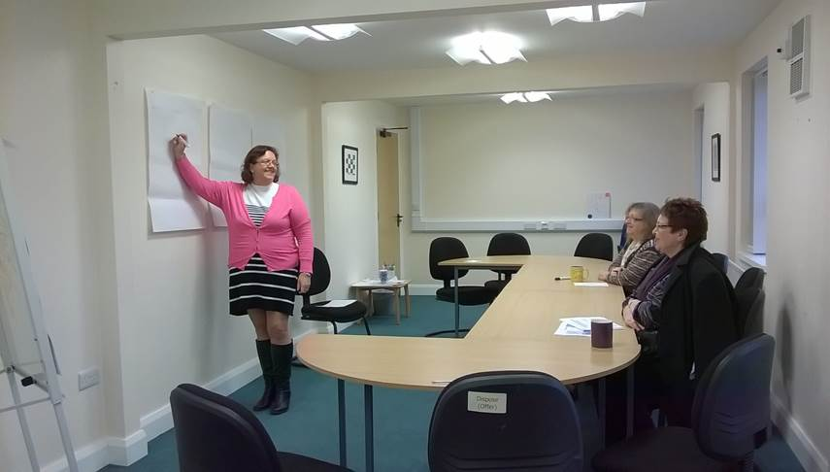
Case study
Notes:
The slide will be discussed in more depth after a group exercise. The language of the dynamic risk assessment tool and the language used in CP conferences is much the same.

Slide 10
What parents and professionals say

Slide 11
Questions?
Comments?
Notes:
Invite Questions from the floor

