Slide 1
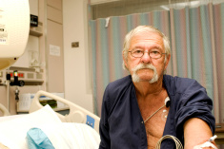
The
Unhealthy
state of
Homelessness
Adult Community Nursing Audit results 2015/16

Slide 2
Understanding the issue
Homeless people are some of the most vulnerable in our society
The agreed definition of homelessness includes not just rough sleepers but all those who are sofa surfing, in temporary, unsuitable, and poor quality accommodation
Homelessness Kills; there is increased mortality and morbidity
UK research shows when homeless people do seek help they are often sicker, rates of hospitalisation are higher, inpatient stays are longer and they need more intensive treatments.

Slide 3
IOM Homeless Health Check Key Findings
96%
of people reported
physical health problems
92%
Said this was a long-term problem
(12 months+)
94%
reported some form of mental health issue
58%
Had been diagnosed with a mental health issue
25%
Have or are recovering from an alcohol problem
25%
Said they take drugs or are recovering from a drug problem
51%
Had been to A&E over the past six months
47%
admitted to hospital in the past six months
Worse than the general public | Health issue | IOM Homeless population | UK Homeless population | General UK population
Physical, mental and substance misuse issues remain prevalent among the homeless population and at levels that are much higher than those experienced by the general population. | Long term physical health problems | 92% | 41% | 28%
 | Diagnosed and Undiagnosed mental health problem | 94% | 45% | 25%

Slide 4
IOM Homeless
UK Homeless
96%
of people reported
physical health problems
92%
Said this was a long-term problem
73%
of people reported
physical health problems
41%
Said this was a long-term problem
94%
reported some form of mental health issue
58%
Had been diagnosed with a mental health issue
80%
reported some form of mental health issue
45%
Had been diagnosed with a mental health issue
25%
Have or are recovering from an alcohol problem
25%
Said they take drugs or are recovering from a drug problem
27%
Have or are recovering from an alcohol problem
39%
Said they take drugs or are recovering from a drug problem
51%
Had been to A&E over the past six months
47%
admitted to hospital in the past six months
35%
Had been to A&E over the past six months
26%
admitted to hospital in the past six months

Slide 5
42% of homeless people used the IOM Ambulance Service within the past 6 months
9% Relating to mental health
4% result of an accident
9% violent incident or assault
13% Self harm
30% other
17% Breathing problems/ chest pains
4% relating to alcohol use
9% Seizures
1-2 times | 3-5 times | Over 5 times
29% | 5% | 7%

Slide 6
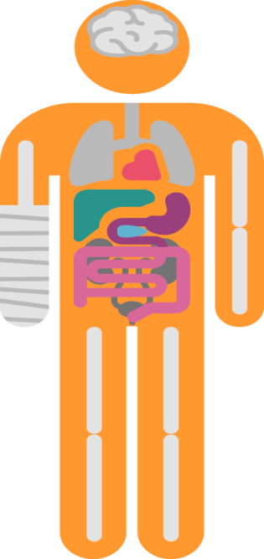
51% of homeless people have visited
Nobles Hospital A&E within the past 6 months
7% violent incident or assault
14% result of an accident
4% Relating to mental health
4% stomach pain
14% infections
11% Breathing problems/ chest pains
14% Self harm
11% Seizures
7% relating to alcohol use
32% Other
1-2 times | 3-5 times | Over 5 times
31% | 11% | 9%

Slide 7
47% of homeless people have been admitted into Nobles hospital within the past 6 months
4% violent incident or assault
4% result of an accident
12% relating to mental health
12% breathing problems/ chest pains
15% seizures
38% other
8% self harm
4% relating to alcohol use
1-2 times | 3-5 times | Over 5 times
40% | 2% | 5%
Average number of nights in hospital 10

Slide 8
IOM – UK Comparison of the use of
Acute and Primary Care Services
IOM Homeless
use of Acute and Primary Care Services
51% Had been to A&E in the past 6 months
38% of homeless people said they had somewhere suitable to go upon leaving hospital
93% of surveyed homeless people said they are either permanently or temporarily registered with a GP
24% of homeless people said they had used opticians in the last 6 months
49% had visited a dentist at least once in the last 6 months
UK Homeless
use of Acute and Primary Care Services
35% Had been to A&E in the past 6 months
64% of homeless people said they had somewhere suitable to go upon leaving hospital
90% of surveyed homeless people said they are either permanently or temporarily registered with a GP
21% of homeless people said they had used opticians in the last 6 months
32% had visited a dentist

Slide 9
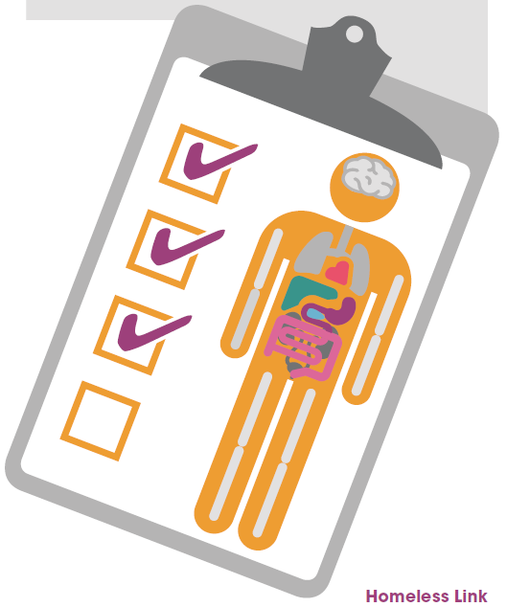
Who helps you the most?
DAT
Mandy Davies
Adult Health Visitor
Diabetic Nurse
Next Step Training Unit
Housing matters
GRAIH
Emily
Police Liaison Officer
Maz
Assistant
Social Worker
Paula Victim Support
GP | A&E Staff | Friend/ peer | Family | Alcohol worker | Drug worker | Mental health worker | Nobody | Other
38% | 5% | 18% | 13% | 8% | 3% | 12% | 8% | 67%

Slide 10
Physical Health
Are you receiving support/treatment to help you with your
physical health problem?
96%
of people reported
physical health problems
47%
Said the support/treatment they receive meets their needs
28%
Said they would like more help/support
19%
Said they are not receiving help/support and would like some
8%
Said they don’t
need help/support

Slide 11
Mental Health
Did you get any support with your mental health from a
DHSC worker, medic or support service?
94%
reported some form of mental health issue
13%
Said the support/treatment they receive meets their needs
27%
Said they would like more help/support
45%
Said they are not receiving help/support and would like some
15%
Said they don’t
need help/support

Slide 12
Drug/Alcohol Use
25% of IOM Homeless people take drugs or are recovering from a drug problem
25% of IOM Homeless people have or are recovering from an alcohol problem
14% of IOM Homeless people advised they get the support to help address their drug use
14% of IOM Homeless people advised they get the support to help with their alcohol problem
43% of IOM Homeless people advised they get the support to help with their alcohol problem but they’d still like more help
29% of IOM Homeless people advised they get the support to help address their drug use but they’d still like more help
44% of IOM Homeless people self-medicate to help cope with their mental health

Slide 13
Alcohol Use IOM – UK Comparison
IOM Homeless
How often do you have an alcoholic drink?
15% Never
22% Monthly or less
15% 2-3 times per week
18% 2-4 times per week
5% 4-6 times per week
25% Every day
UK Homeless
How often do you have an alcoholic drink?
25% Never
25% Monthly or less
5% 2-3 times per week
16% 2-4 times per week
14% 4-6 times per week
15% Every day

Slide 14
IOM Homeless
On average how many units do you drink on a typical day?
17% 1-2 units
9% 3-4 units
19% 5-6 units
17% 7-9 units
38% 10+ units
UK Homeless
On average how many units do you drink on a typical day?
16% 1-2 units
22% 3-4 units
16% 5-6 units
11% 7-9 units
35% 10+ units

Slide 15
Smoking
78% of IOM Homeless people smoke
53% of IOM Homeless people were offered help to stop smoking but struggled to give up
19% of IOM Homeless people were offered help to stop smoking and took this up
26% of IOM Homeless people have not been offered help to stop smoking
53% of IOM Homeless people would like to stop smoking

Slide 16
62% of IOM homeless people consider themselves to have a disability
69% of IOM homeless people believe their health stops them from being able to undertake any training, volunteering or employment that they want to do

Slide 17
Wellbeing
On average 56% of IOM Homeless do not eat 2 meals a day
On average 35% of UK’s Homeless
do not eat 2 meals a day
69% of IOM Homeless have zero fruit and veg a day

Slide 18
How would you describe where you are currently sleeping
“Living in almost derelict house with holes in roof and rain coming down the stairs”
“House – Good facilities but leaves me with very little money to live on”
“In charity accommodation (temporarily), 2 weeks ago I was in a tent on Douglas Head”
“Got a flat but no hot water or heating”
“Boarding House – no cooking or laundry facilities”
“Very substandard flat, windows broken, no hot water, damp……”

Slide 19
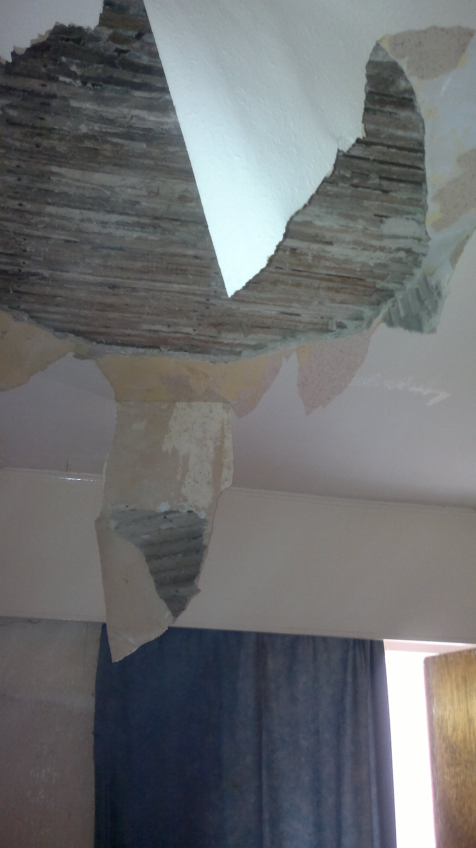
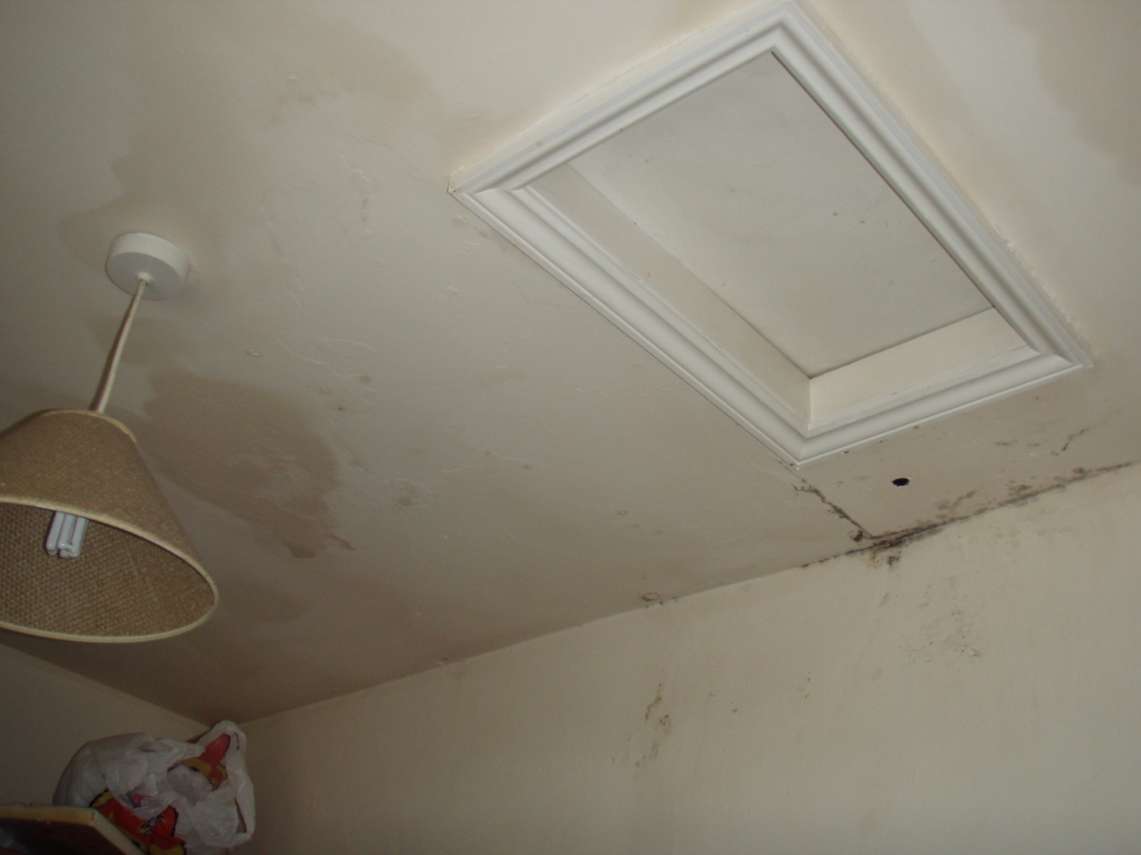
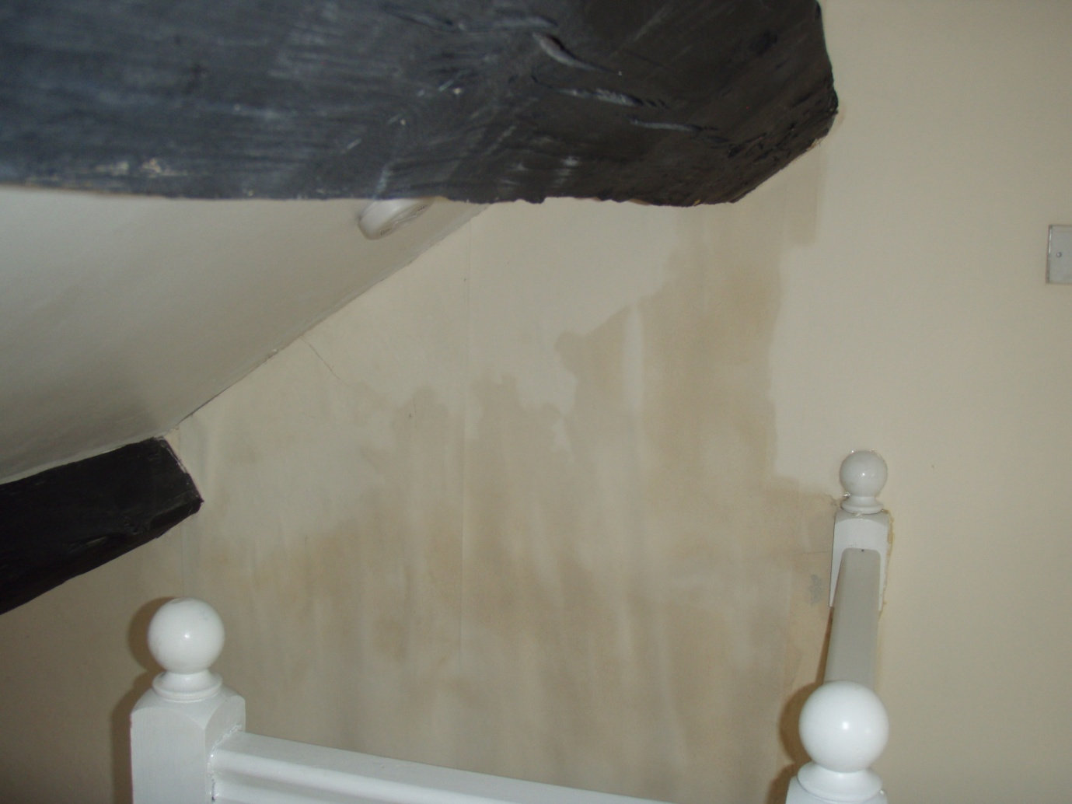
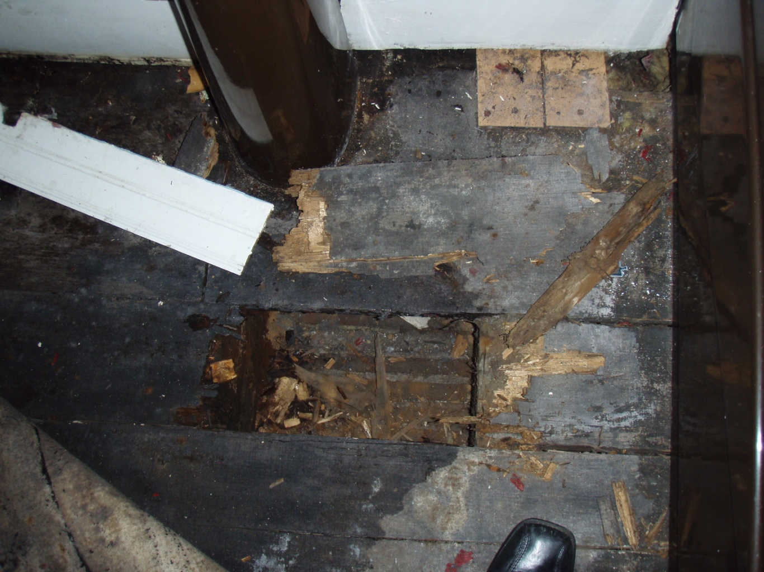
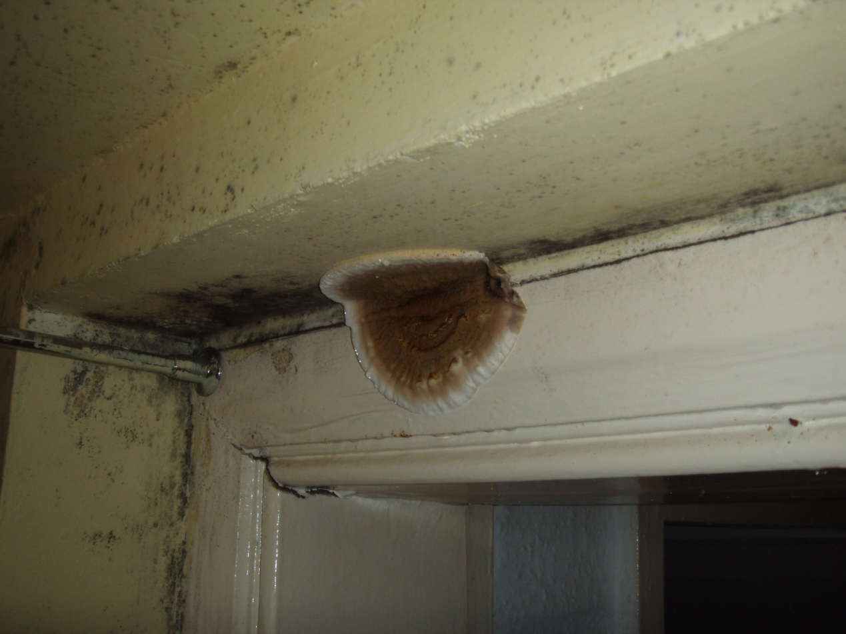
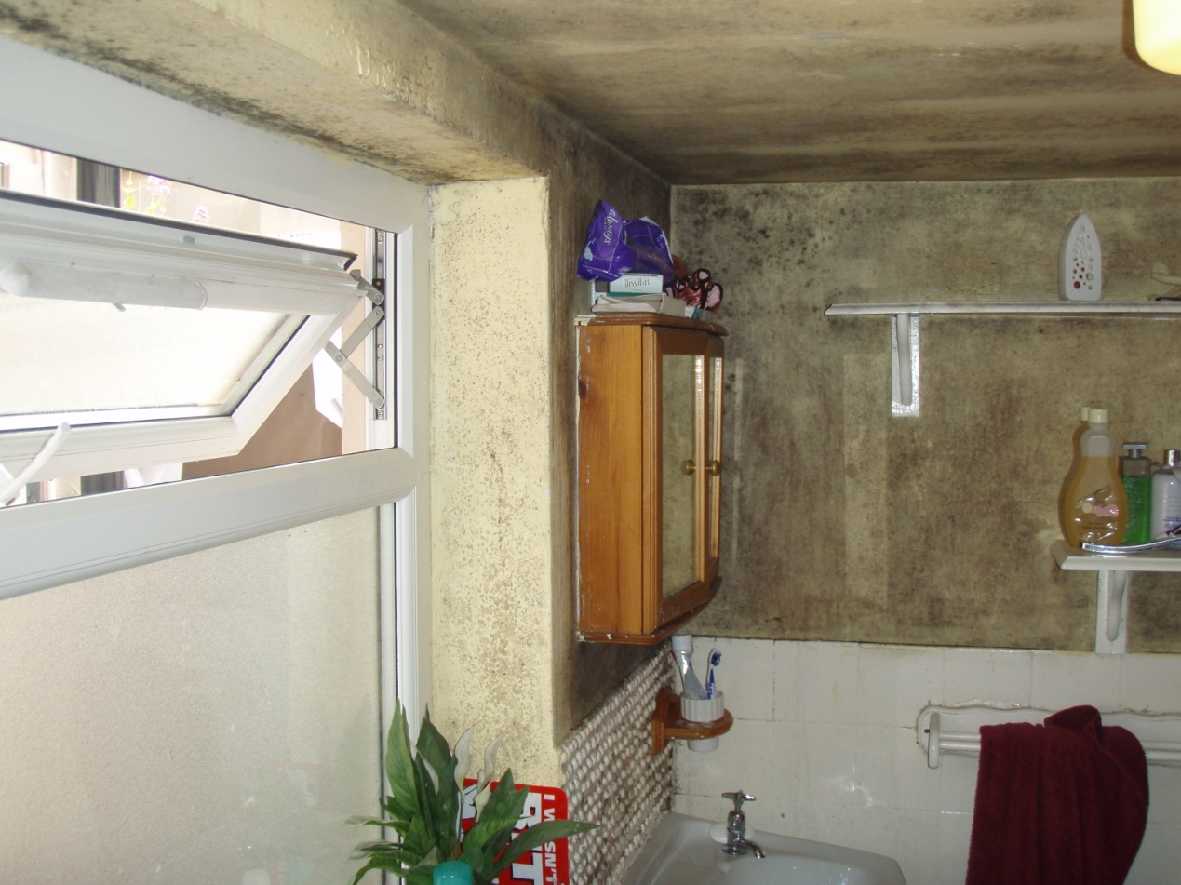
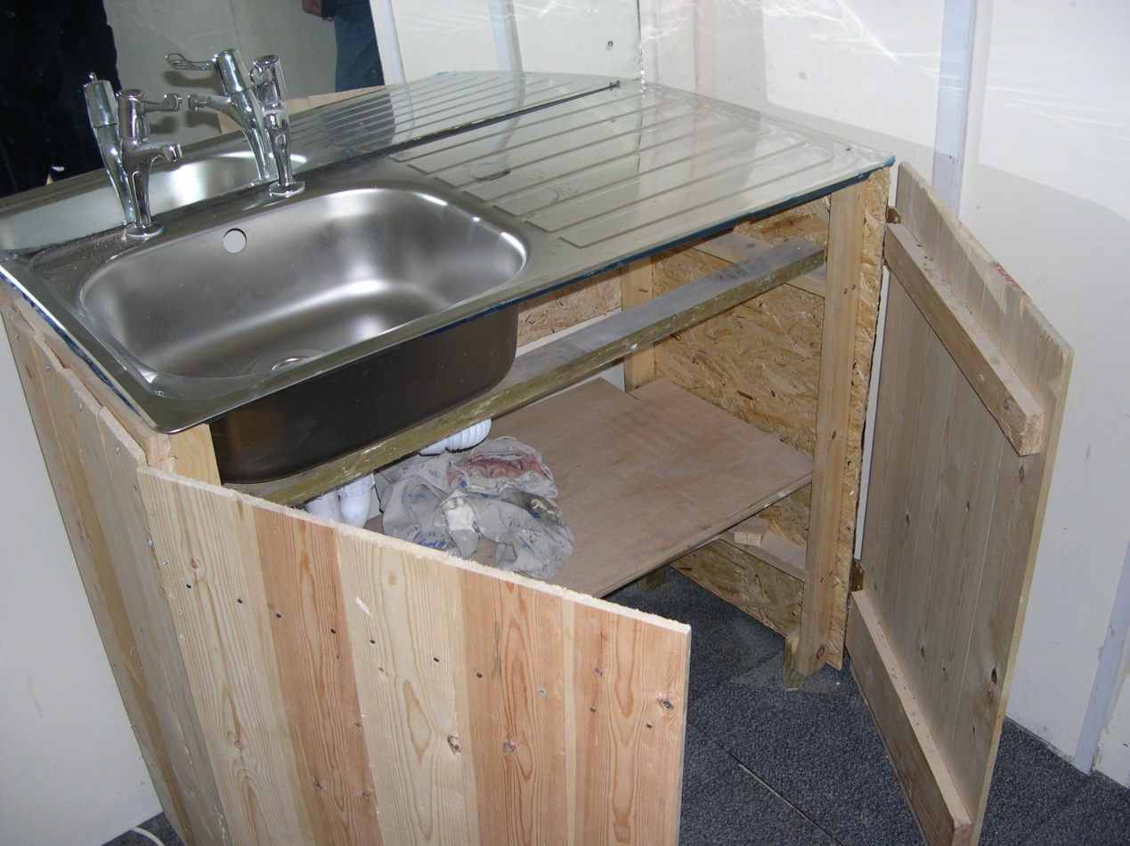
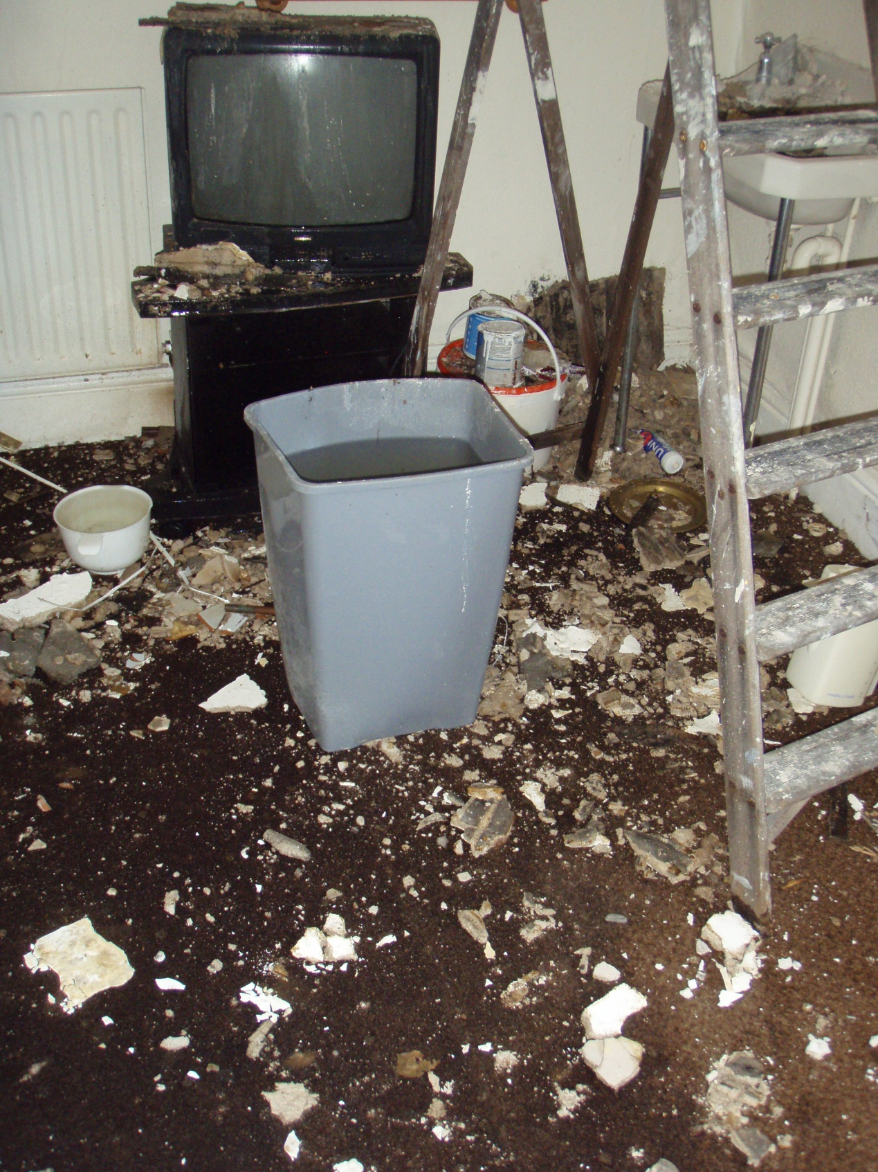
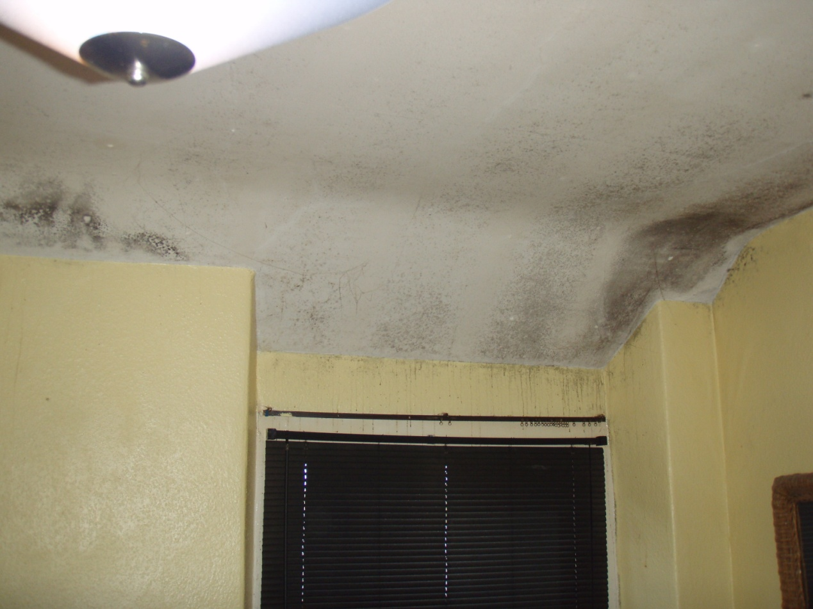
Accommodation
Fungal rot
Water damage
Fitted Kitchen!
Ceiling down due to water ingress whilst tenant in occupation
Water ingress and black mould

Slide 20
What works well?
“MOTIV8 works well. Geddyn Reesht and Griag Court are a big help”
“Mandy Davies is excellent, I can’t praise her enough. Dentist was also good at Community Health Centre.”
“Victim Support and police have been good. Mandy Davies and Maz are very good Graih and the volunteers are good”
“Venting stress by talking to people. Community Nurse Drop In’s”
“Next Step and Community Mental Health are good. Saturday opening is good and should continue”

Slide 21
“The help I get from David Gray House”
“GP’s and Hospital. My medidose box for medication is good.”
“People like Mandy who listen. Mandy got me seen by a neurologist”
“Easily accessible services where staff are accommodating and friendly and treat you as an individual e.g. Graih”
“I’ve recently had excellent support from Geddyn Reesht and my mental health has improved”
“A GP who listens and understands, seeing the same GP avoiding repeating background. Health Visitor has helped navigate services”
“Graih’s drop in is a big help. I’d be stuck without it”

Slide 22
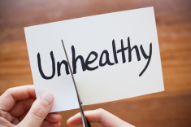
What could be better?
“Mental Health needs more funding. Need more access, and should do more home visits”
“DAT could be better – better communication and more frequent appointments“
“A lot of my problems were not diagnosed years ago by Doctors. They did not listen or care so I isolated myself”
“More drop in clinics”
“Make it easier to get help”
“More help to sort out benefits especially when reading and writing is a problem”

Slide 23
“Staff having more power to access other services records. Personal access to own medical data”
“More practical help with practical tasks. Getting sorted would be good”
“More relapse prevention, integration into working society and a different social circle. More screenings and vaccines”
“Easier access and quicker appointments”
“I was neglected by GP when left bleeding for 6 hours, then when I was seen I was taken straight to hospital”
“Mental Health waiting times. All statutory services are all about lists”
“Better understanding of peoples living standards/ arrangements”
“More information on what help is available”

Slide 24
Anything else you would like to tell us?
“Need somewhere for young homeless to go”
“Glad of the help Mandy has given me, I’ve been able to start my life for the 1st time”
“I needed help earlier”
“Drop-in Community Nurse I find very useful”
“Left in hospital bed unable to go to toilet and had to wet myself. It was good they washed my clothes”
“Drop in at Griah is invaluable”
“I had a long period where isolation and struggling with mental health stopped me from accessing services”
Hospital could have helped me like Mandy did, but I wasn’t offered help for bereavement, dentist, housing benefits, smoking etc.”
“Thank you for asking”

Slide 25
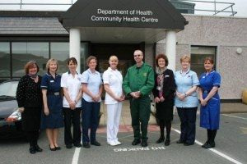
What have we learnt from our audit?
There is a need to improve care for homeless people in the Isle of Man
Homelessness and Health cannot be tackled in isolation
Services need to be proactive, flexible, holistic and work together in order to address the complex needs of homeless people

Slide 26
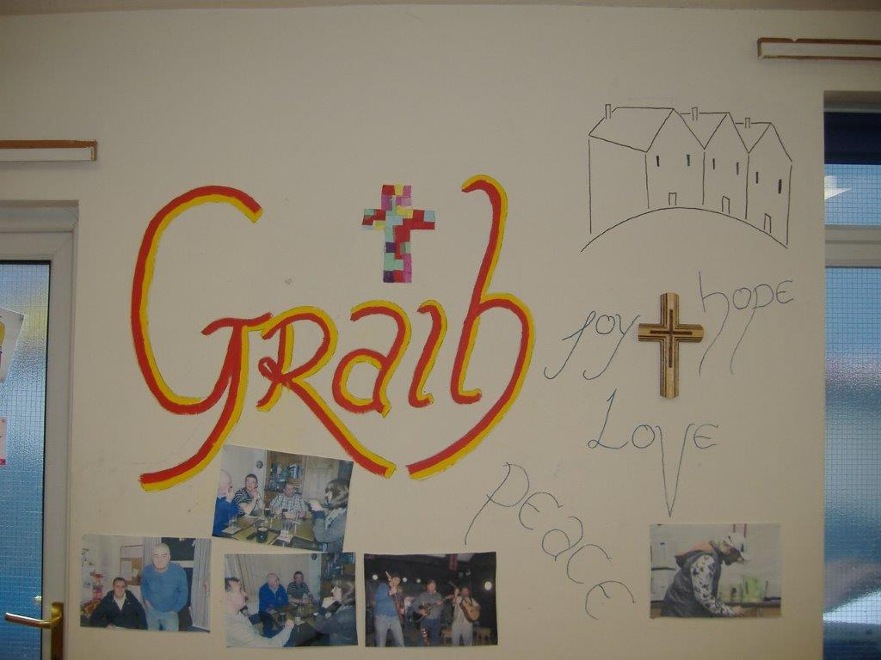
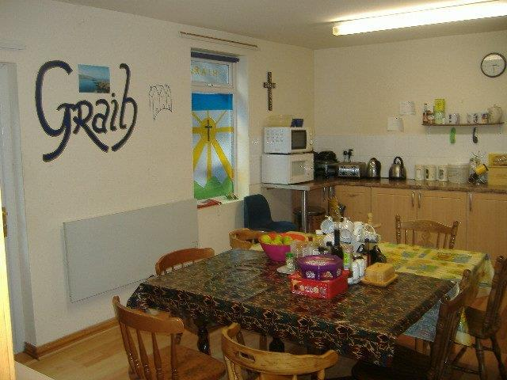
Any Questions or Queries?
Mandy Davies
Specialist Health Visitor for Vulnerable Adults
Telephone No: 665941
Michael Manning
GRAIH
Telephone No: 324767

