Slide 1

General Data Protection Regulation
24th January 2018
Palace Hotel
Douglas

Slide 2
General Data Protection Regulation
AGENDA
Hon. Chris Thomas MHK – Minister, Policy and Reform
Dan Davies– Director, Change and Reform
Carl Hawker – Department for Enterprise
Chris Allen – Chamber of Commerce
Iain McDonald – Information Commissioner
Q&A Panel

Slide 3
General Data Protection Regulation

Slide 4
Minister for Policy & Reform
Hon. Chris Thomas, MHK

Slide 5

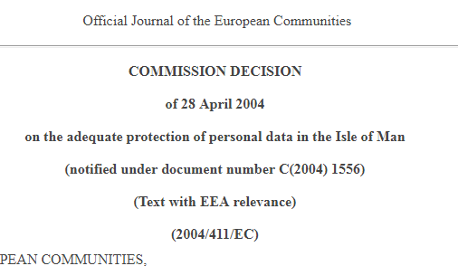
General Data Protection Regulation
Approach
Commitment to maintain adequacy decision after GDPR

Slide 6
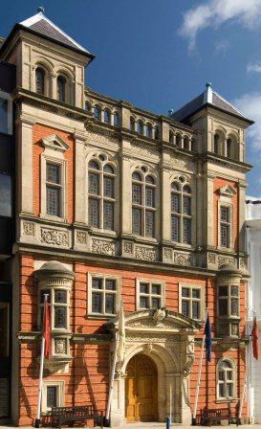

General Data Protection Regulation
The detail
A short Bill
Gives powers to apply EU data protection instruments directly into Manx Law

Slide 7
General Data Protection Regulation

Slide 8
Director of Change & Reform, Cabinet Office
Dan Davies

Slide 9
General Data Protection Regulation
“GDPR and the Isle of Man”

Slide 10

Two Orders
GDPR
LED
Law Enforcement Directive

Slide 11
Give detail
Safeguards
Supporting Regulations
Set out process
Qualify areas of difference

Slide 12
General Data Protection Regulation
Major features
Six data protection principles applied
Information Commissioner will be the Supervisory Authority in relation to GDPR and the LED
Significant new powers for the IC
Same rigorous consent regime
Same enhanced rights for data subjects
Data Protection Officers

Slide 13

Data protection principles
Processed Lawfully, Fairly & Transparently
Collected for specified, explicit and legitimate purposes
adequate, relevant and limited to what is necessary
accurate and, where necessary, kept up to date
kept in a form which permits identification of data subjects for no longer than is necessary
processed in a manner that ensures appropriate security of the personal data

Slide 14

Supervisory Authority (Article 51 of GDPR)
Articles 57 & 58 of GDPR apply in full
Information Notice
Enforcement Notice
Penalty Notice
(up to £1m)
Assessment Notice
Breach reporting (Article 33)
Notification process will continue

Slide 15

Data Protection Officer
Articles 37-39
Knowledge
Support
Authority
May be staff or service contract

Slide 16
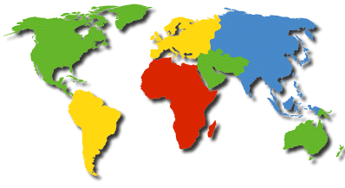

Other areas of note
          Transfers to countries without adequacy to be approved by ICO
          Audit powers for ICO
Consideration of transitional provisions
Exemptions

Slide 17
General Data Protection Regulation
Conclusion
GDPR directly applied into Manx legislation
Some parts of the DPA retained to minimise impact of change
Regulations out for consultation now
Take a risk-based approach
Follow good practice – there’s lots out there

Slide 18
General Data Protection Regulation

Slide 19



The Economic Impact of the General Data Protection Regulations
Carl Hawker | 24th January 2018

Slide 20
Agenda
Introduction – The importance of Data in new economy
Impact of GDPR on Business
Impact of GDPR upon the Economy
Opportunities for the Isle of Man

Slide 21

Introduction
“Data is the new oil”
“Data is fundamental in driving the ways in which businesses and governments communicate with consumers and how consumers chose goods and services”

Slide 22
Aspects of the Digital Economy
Cross Border/Virtual
Fastest growing part of Local economy.
European Union is the world’s largest single market.
Accessing that market requires customers data to be professionally managed.
GDPR sets that those rules
Isle of Man needs to demonstrate “adequacy” of local laws to meet requirements of GDPR and be allowed to control data on EU Nationals.

Slide 23

A Growing importance to Economists

Slide 24
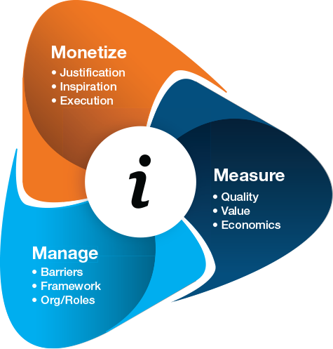
The Economics of Information
Monetize - How to create value from your information
What value does your information have either to you or a customer ?
How do you collect and organise your information in a structured way
information has value because of asymettries

Slide 25
Who does this well at present ?
Facebook, Google, Amazon
E-Gaming Companies
Large Retailers
GDPR aims gives the power of use of data back to the user and challenges unrestricted use of it. Companies will need to build trust with customers to be able to use their data and create value.

Slide 26
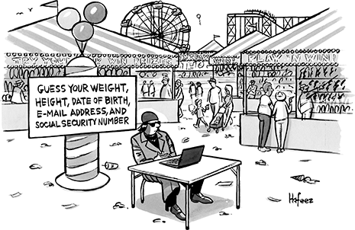
Impact Upon Businesses
Reducing the “bureaucracy” involved in current data protection regimes means that economic growth, innovation and job creation will be encouraged.

Slide 27
Impact Upon Businesses
Cutting Costs
  The Regulation will establish a single law for data protection not 28. The new rules will bring benefits of an estimated €2.3 billion per year.
Improving Trust
  Individuals’ trust in a company’s ability to protect personal data is at an all-time low (8/10 respondents felt they don’t have control over their data)
  Compliance means customer and data security is enhanced and improved ensuring data protection to the highest level, helping data transfer and storage remain compliant – and therefore cost-effective.
  TalkTalk admitted that their data breach cost them 95,000 customers!

Slide 28
Impact Upon Businesses
Data portability
  Smaller companies will be able to access data markets dominated by digital giants and attract more consumers with privacy-friendly solutions
  This will make the European economy more competitive
The public sector
  Using “big data” to increase efficiency could save European governments as much as £266bn (€300bn)
More use of Cloud-based services
  Remote storing and processing of data on computer servers – the trust in the EU’s coherent regulatory regime will be a key asset and attractive point for investors

Slide 29
Impact Upon Economy - EU
The EU data market was worth €54.5bn in 2015, and would be up to €84bn by 2020
It employed 6 million people in 2015 and could employ 7.4m people by 2020 in the EU.
In 2015, its value was estimated to €272bn but this could grow to be 3.17% of EU GDP (€643bn) by 2020.

Slide 30
Impact Upon Economy - UK
UK Data Economy
  This industry generated £4.8 billion in gross value added
  up to 73,000 full time equivalent jobs
  Global market research firms account for approximately half of these figures.
  The data analytics sector is still relatively small, generating between £355 million and £497 million in gross value added and employing between 4,800 and 6,700 full time equivalents in 2016. However, it is a fast growing sector. It grew 350% between 2012 and 2016.
Reducing cross-border barriers
  The single regulatory framework makes expansion to another member state easier and more cost-effective.

Slide 31

Some opportunities for the Isle of Man
Hold more data - Tier III and IV Data Centres
Become experts in using customer data – learn from the expertise of the Gaming sector in organising and monetizing data.
But only if we can access data and that means being able to access the largest markets.

Slide 32
carl.hawker@gov.im

Slide 33
General Data Protection Regulation

Slide 34
General Data Protection Regulation
“GDPR: the view from industry”
Chris Allen
President
Isle of Man Chamber of Commerce

Slide 35
General Data Protection Regulation

Slide 36
Iain McDonald Information Commissioner

Slide 37
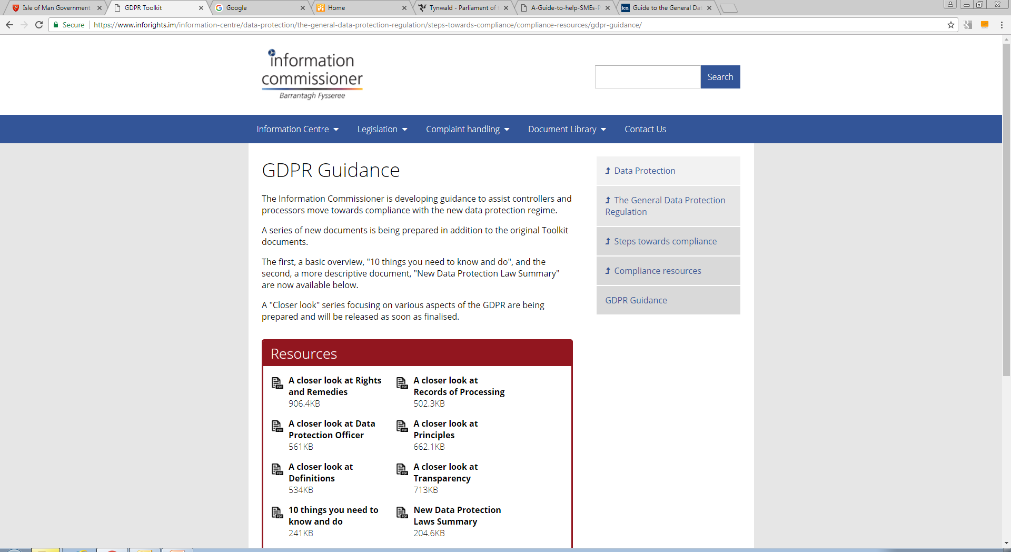
IOM Guidance

Slide 38





IOM Guidance
Know your Data
GDPR Toolkit:
Getting ready for the GDPR -Mapping the 5Ws:
Data
Why
Why
Why
Who
What
When
Where

Slide 39
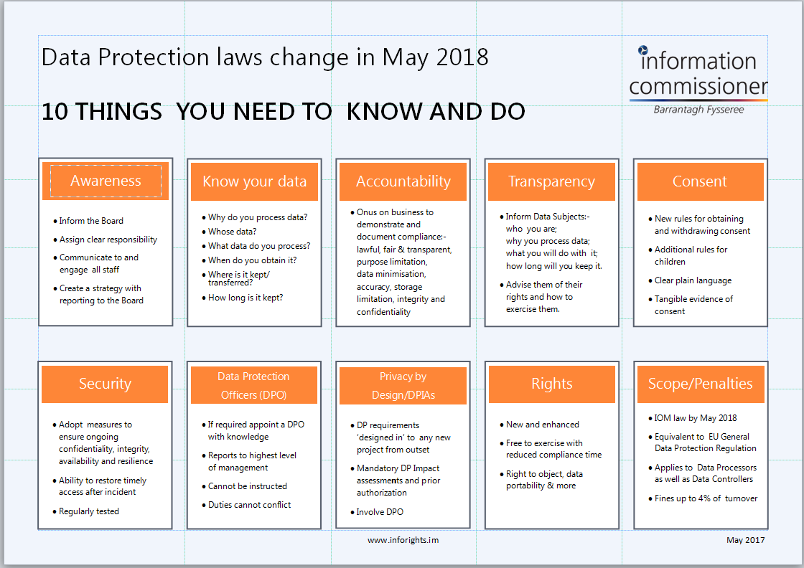
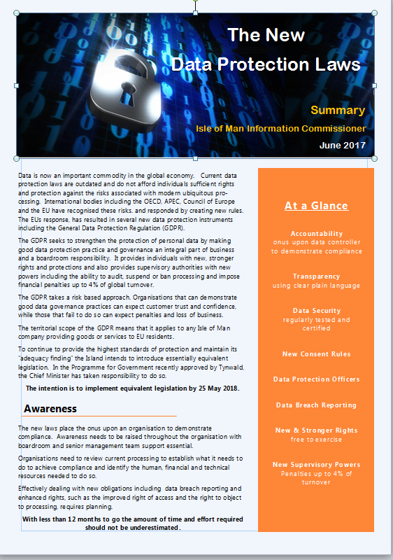
Overviews
www.inforights.im

Slide 40

    Published:
    Definitions
    Transparency
    Principles
    Data Protection Officer
    Records of processing
    Rights
    Intended:
    Accountability
    Security
    Consent

Slide 41
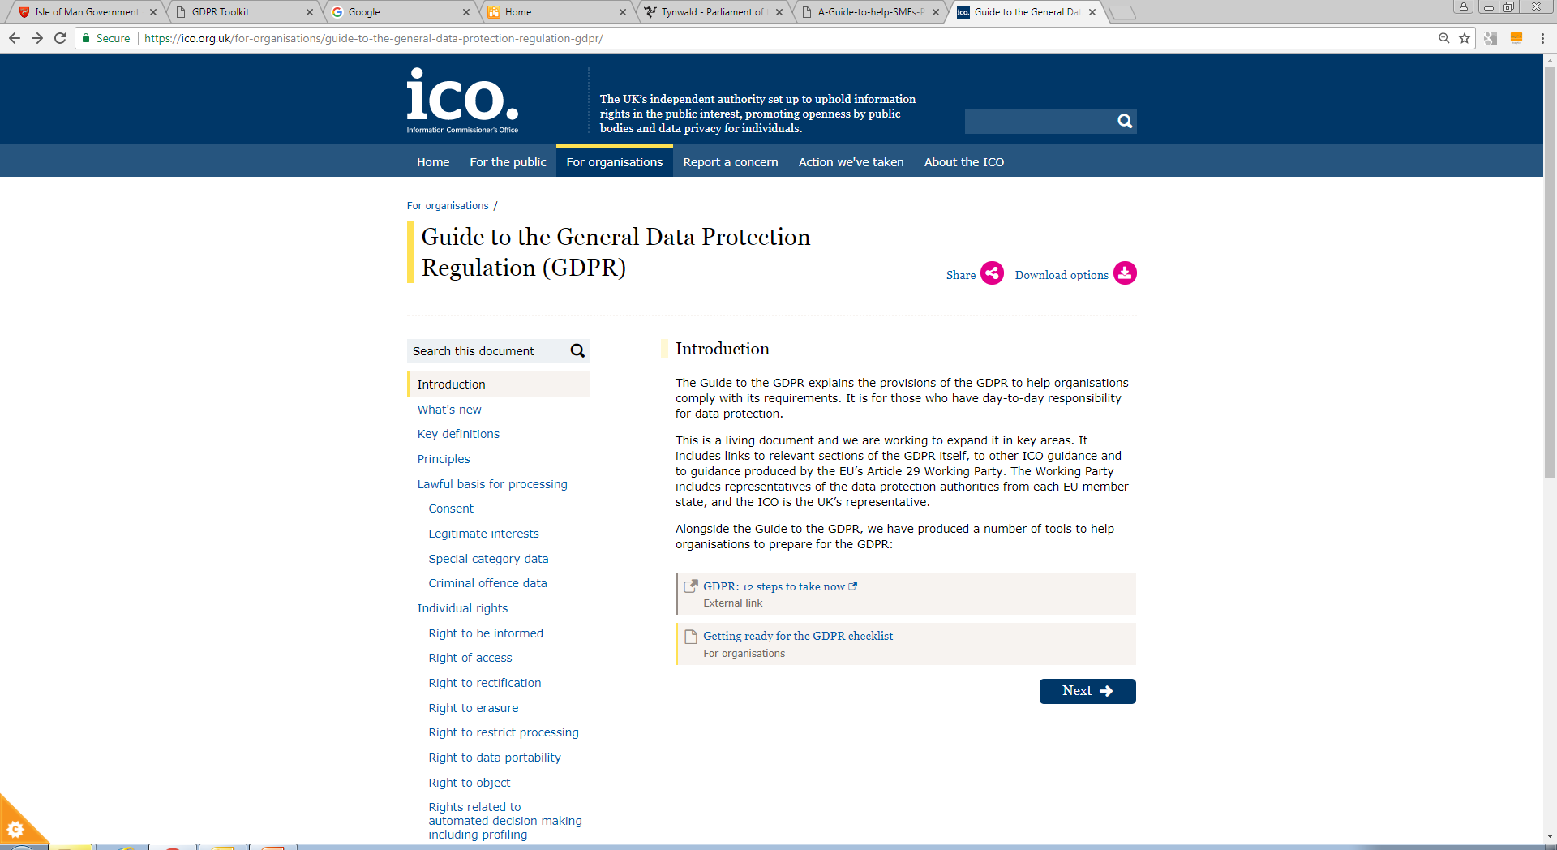
UK Guidance
ico.org.uk

Slide 42
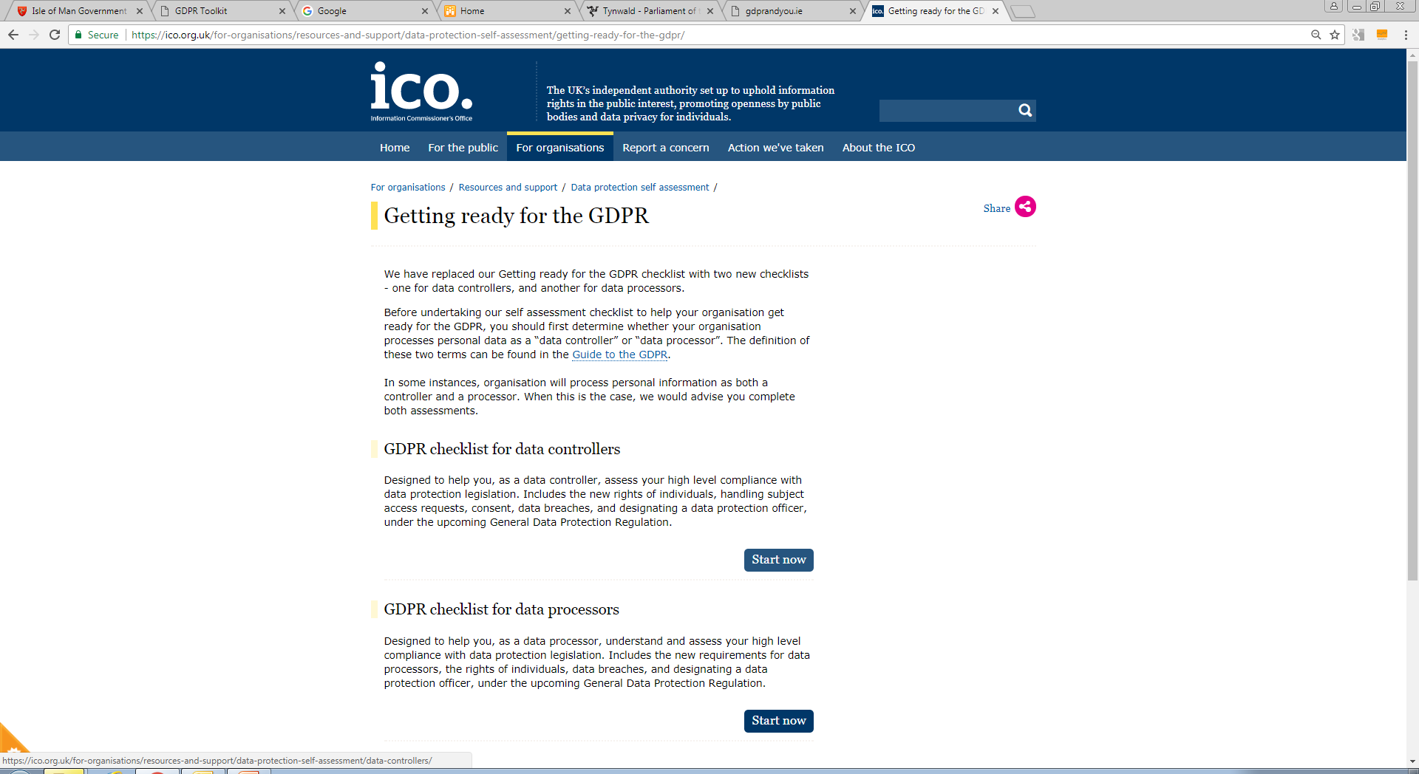
UK Guidance
ico.org.uk

Slide 43
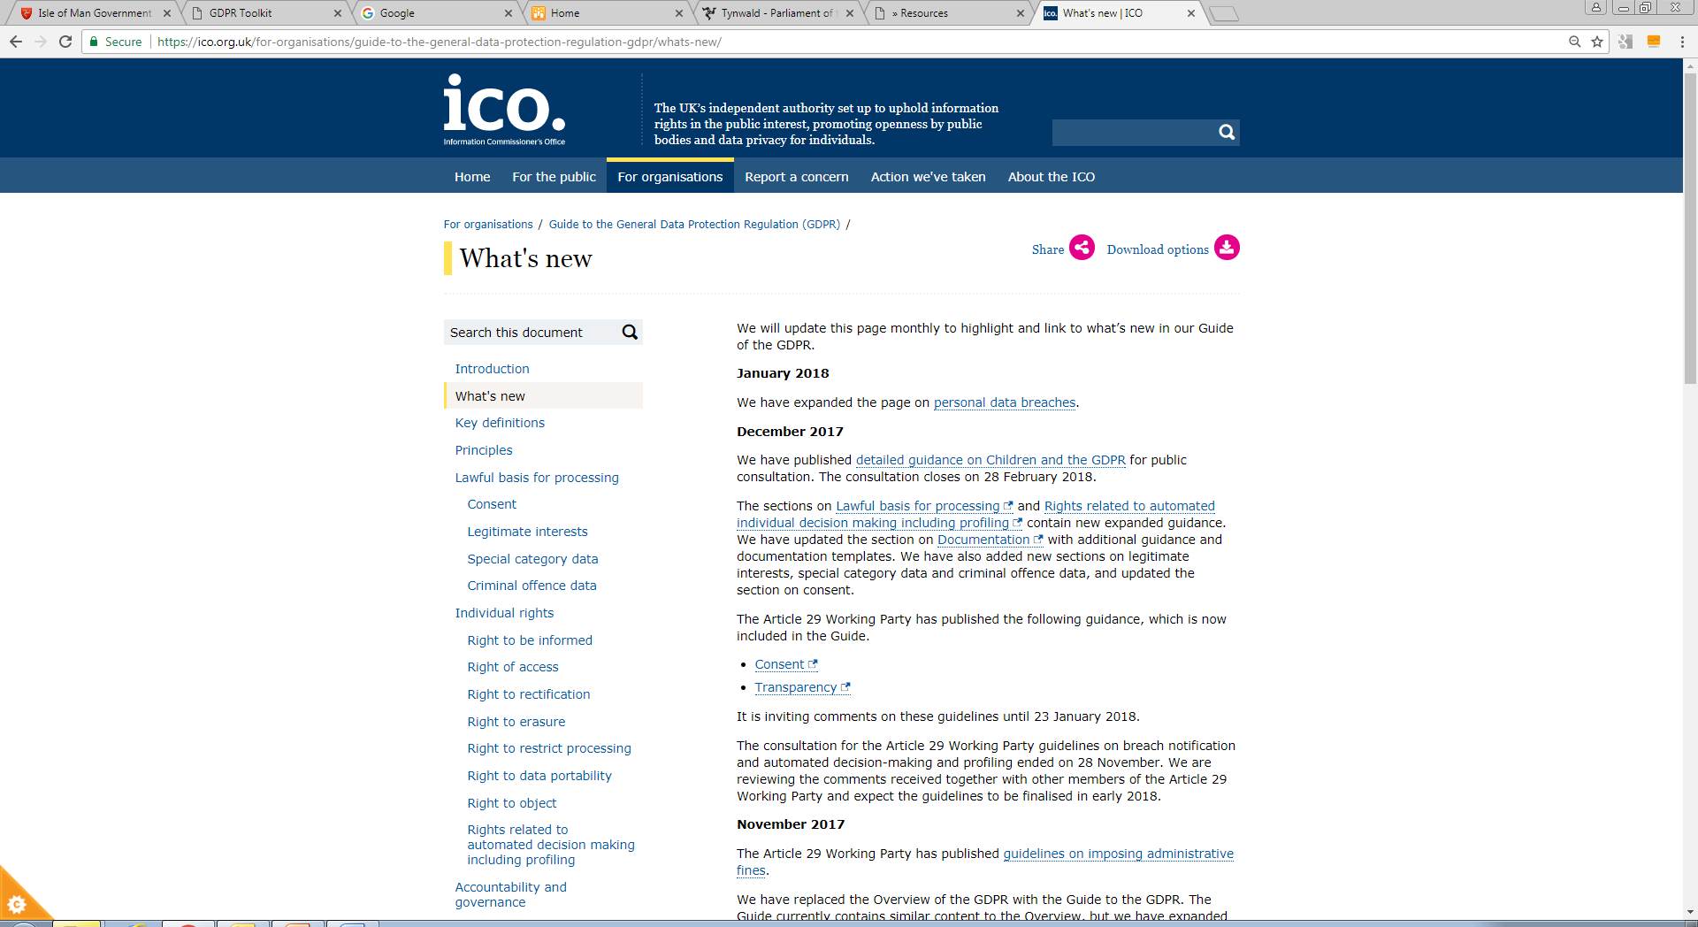
UK Guidance
What’s New
ico.org.uk

Slide 44
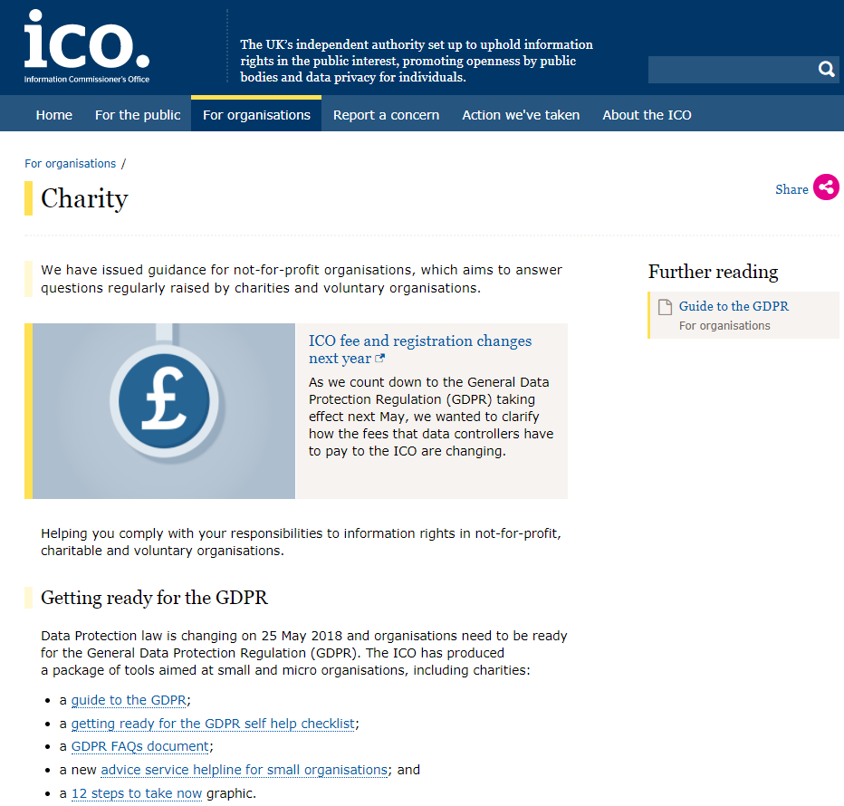
UK Guidance

Slide 45
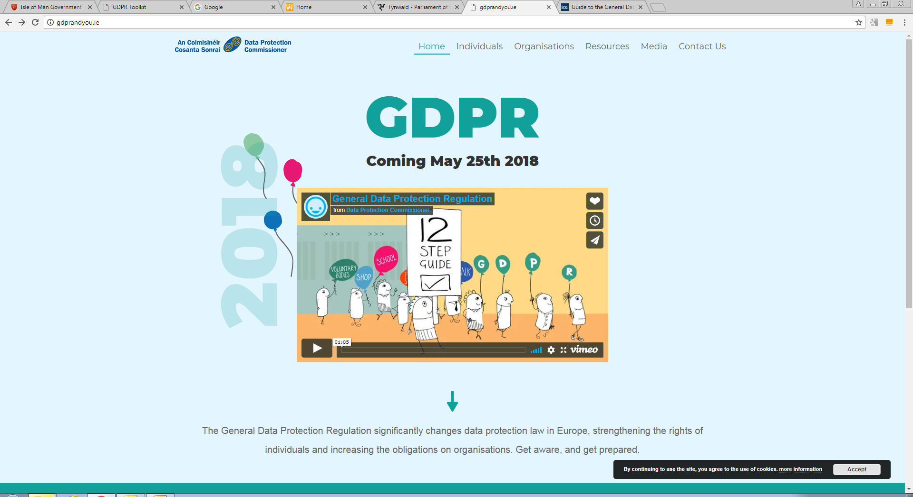
Ireland Guidance
gdprandyou.ie/

Slide 46
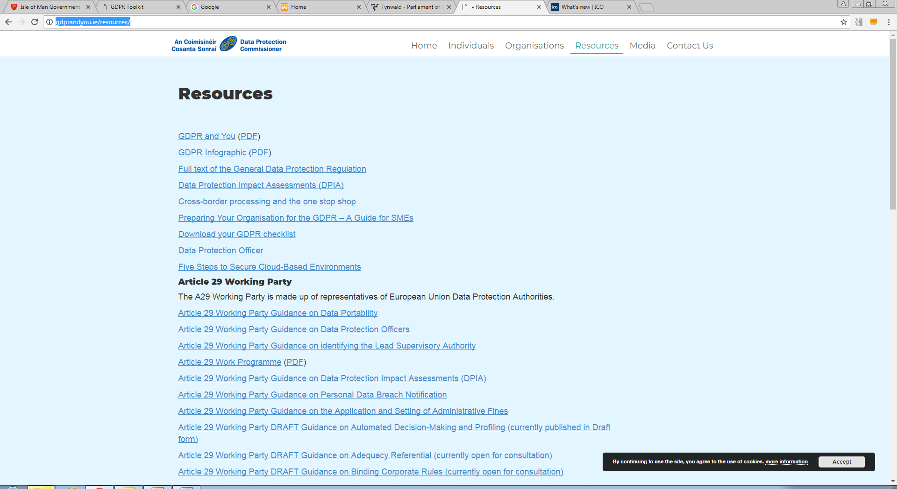
Ireland Guidance
Resources :
gdprandyou.ie/

Slide 47
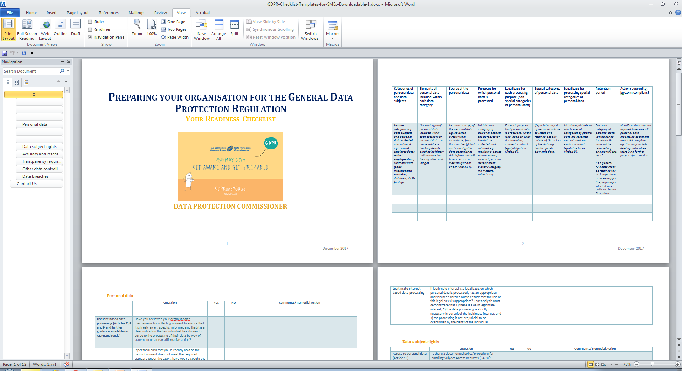
Ireland Guidance
Resources : Your readiness checklist
gdprandyou.ie/

Slide 48
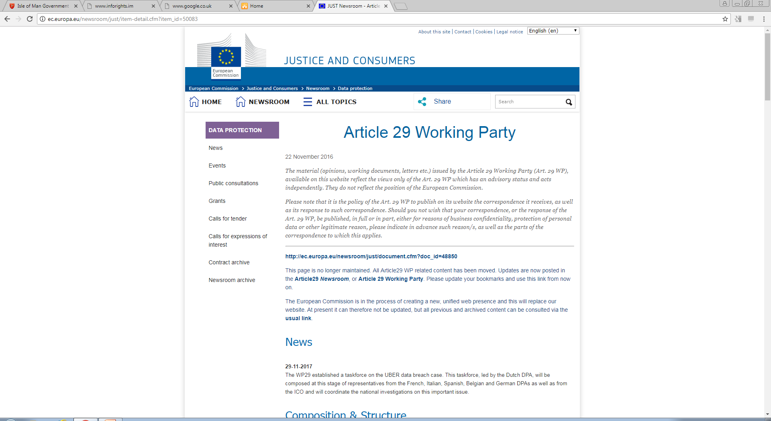
Art29 (EDPB) Guidance

Slide 49
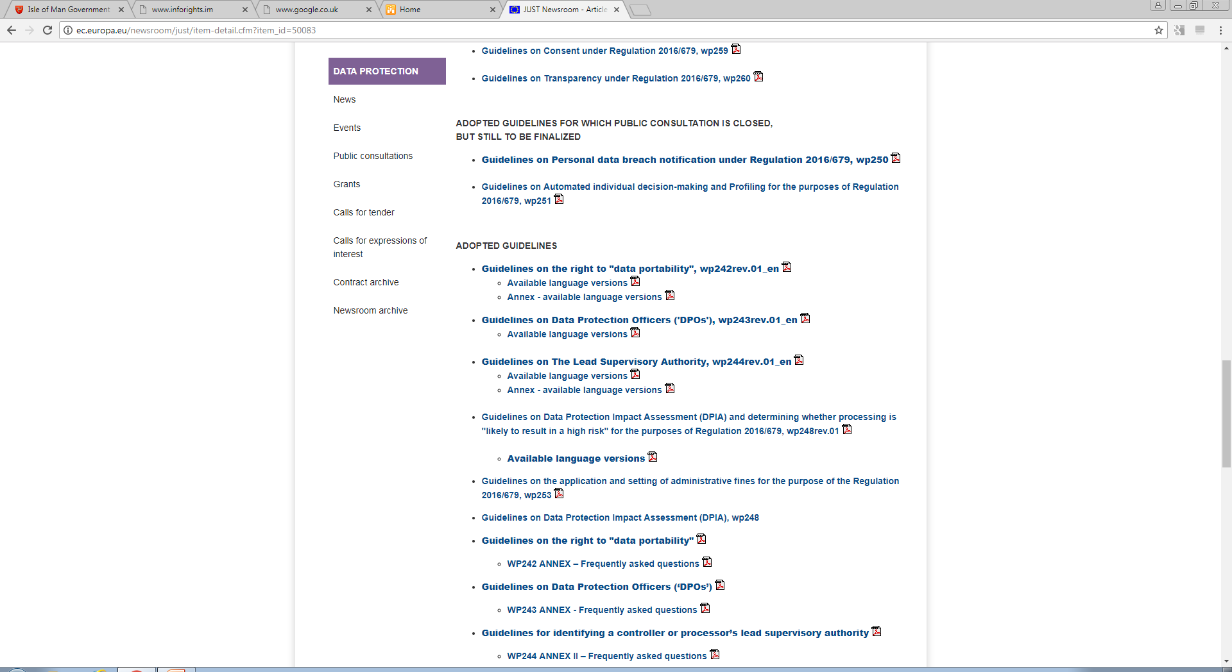
Art29 (EDPB) Guidance

Slide 50
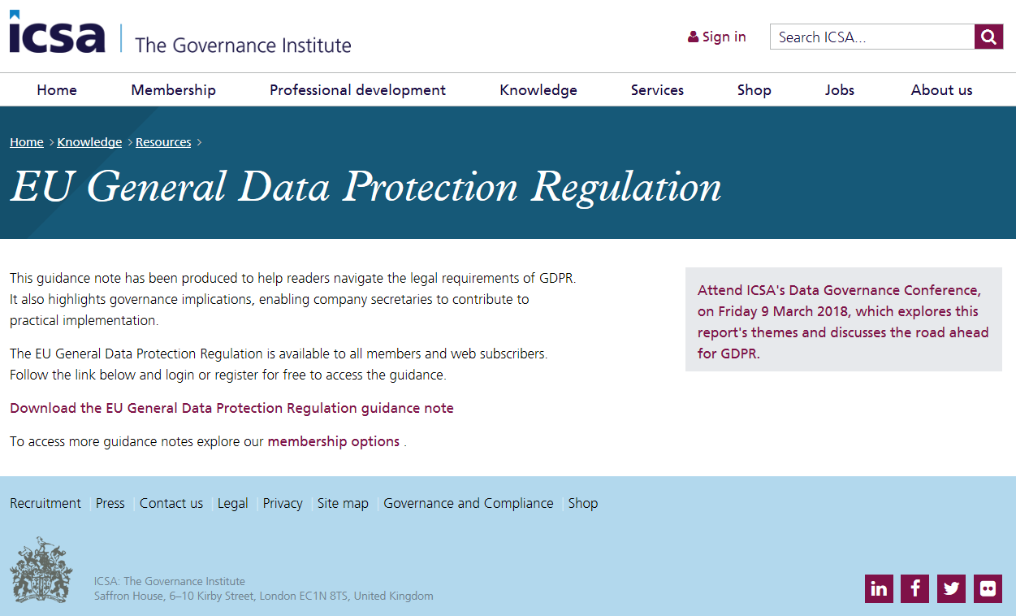



Sectoral Guidance
ICAEW
ICSA
Microsoft
Law Society

Slide 51
finally …..

Slide 52
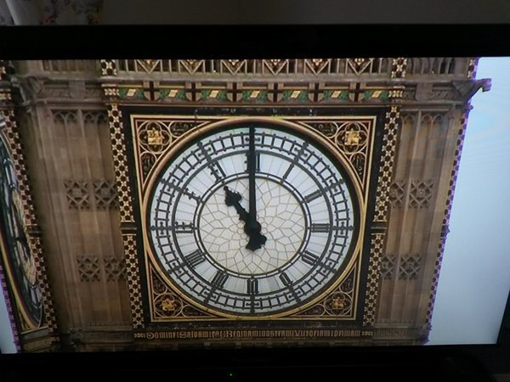
GDPR
REGULATION 2016/679
25 MAY 2018
85 working days
but …

Slide 53
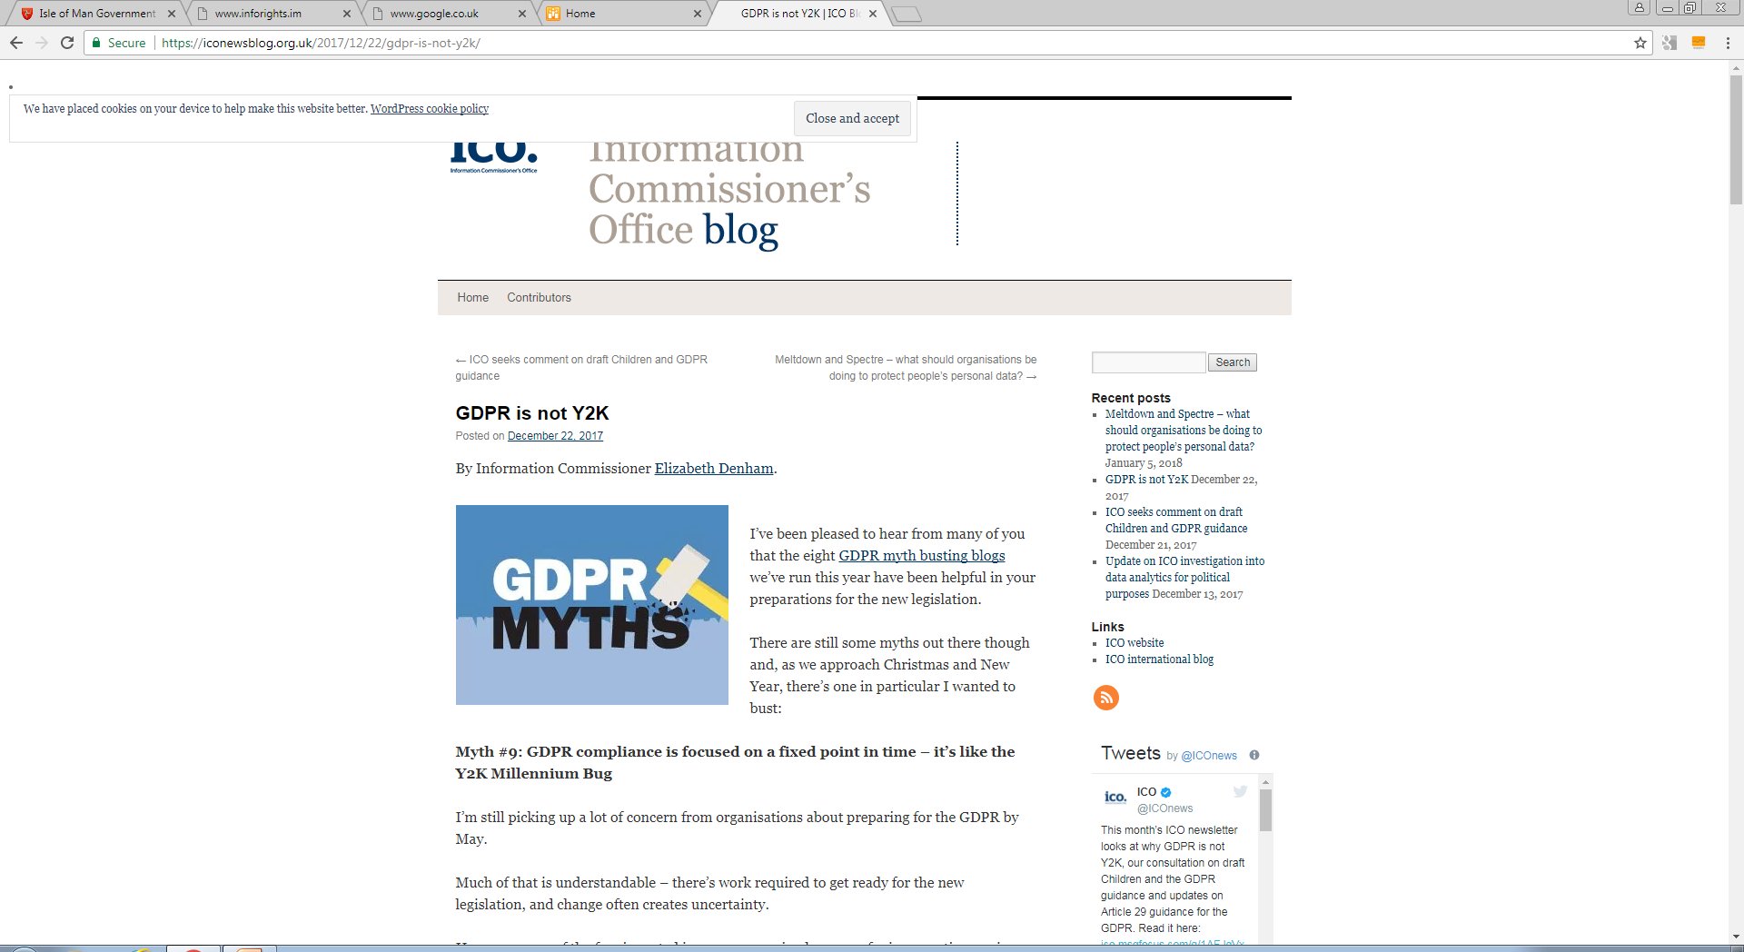
GDPR is not Y2K

Slide 54
General Data Protection Regulation

Slide 55
General Data Protection Regulation
Panel discussion and audience Q&A

Slide 56
General Data Protection Regulation
Chris Allen – President, Chamber of Commerce
Duane Allen – Attorney General’s Chambers
Bryan Beesley – KPMG
Carl Hawker – Department for Enterprise
Iain McDonald – Information Commissioner
Nicola Pitts - Attorney General’s Chambers
Hon. Chris Thomas MHK – Minister, Policy and Reform

Slide 57
General Data Protection Regulation
24th January 2018
Palace Hotel
Douglas

